Slide 1

Module 2 Part 3:
Current Real-time HIS Data Management Solutions
HP-II Workshop on Real-time Hydrological Information Systems
Mark Heggli, Meteorologist/Hydrologist
Expert Real-time Hydrology Information Systems
Innovative Hydrology, Inc.
Consultant to the World Bank

Slide 2
Examples that refer to products are intended for illustrative purposes only, and do not imply an endorsement or recommendation of any particular product

Slide 3
Why Data Management
Real-time HIS requires both monitoring equipment as well as a data transmission solution
  Data Transmission solutions ideal for India include
    GSM/GPRS
    INSAT
    VSAT
    Etc.
Data Center components can be acquired separately, but data reception solution must be part of the tender
  INTERNET Connection for GSM/GPRS
  Ground Station for INSAT
  Master Control Station for VSAT
  Etc.
Notes:
Why Data Management <c> Real-time HIS requires both monitoring equipment as well as a data transmission solution. <c> Data transmission solutions ideal for India include <c> GSM/GPRS otherwise known as the mobile phone network, <c> INSAT, which is the Indian Meteorological Satellite that has a transponder for data relay from remote ground stations <c> VSAT, which is a private satellite that offers TCP/IP connectivity. There are other data transmission solutions, though this list is suitable for our description.
<c> Data center components can be acquired separately, but the data reception solution must be part of your HIS procurement, otherwise there will be no way to commission an operating HIS. A computer system should be included to <c> collect data over the Internet from the GSM/GPRS data transmissions, or <c> a ground station to collect data that is being relayed through INSAT, or a <c> Master control station, to collect data being transmitted through VSAT. By the way, VSAT can also operate over an Internet connection, for the ground receive aspect of the operation. The transmissions from the field will however go through the VSAT satellite and then relayed to the providers ground station, and then relayed over the internet to your data center.

Slide 4
Data Management Topics
It follows that Data Management Solutions fall into two general categories
  Software
  Hardware

Slide 5
Modernized HIS Data Flow
Data Reception
Raw Data Storage
Field
Decision Support
Quality Assurance and Archiving
Real-time WEB
Provisional – Subject to Change
Data Filter
Record Review
Flood Forecast
WEB Server
Time Series
Forecast Storage
Archive Storage
Notes:
Modernized HIS Data Flow. This diagram has been prepared to show the flow of information once the data has arrived in your HIS Data Center. <c> data is received by the data reception system and <c> passed on to the data base in raw form. <c> Data which is collected would be immediately posted on a web site as provisional data, and noting that the data is subject to change.
<c> The data would also simultaneously flow to what could be a decision support system. The DSS would initially <c> Filter the data, removing artifacts, and then submit the information to <c> a flood forecast scheme, after which the <c> forecast would be disseminated and stored.
<c> a third route for the data would be a Quality Assurance and Archiving function, which would serve the purpose of providing “data for record”, otherwrise known as the best data available. In this process, the <c> data would be subjected to review, and employing a <c> time series data quality control system. <c> data would then be placed in a data base, and delivered by the web server. <c> The basis for the quality assurance will be maintenance logs produced during field visits. These logs must make their way back to the HIS so that the information can be processed in developing the best data set possible.

Slide 6
Software Components and Principles of a HIS Data Management System
Data Collection Module
Data Base Module
Quality Control Software (Time Series Software)
Maintenance Management Module
Data Analysis Software: Alarms
Data Visualization Module
Data Dissemination Module
Ancillary Software Modules
Notes:
Software components and principles of a HIS Data Management System. The software components most commonly include <c> a Data Collection Module, for the collection of the transmitted data from the remote stations <c> a data base module, to store your hydrological data, <c> a quality control software package, to process time series software, including the correction of data that is in error, <c> a maintenance management module that can be used to track all maintenance activities of the HIS, this would include both field equipment as well as equipment located in the Data Center, <c> data analysis software, that may include a software module to evaluate the data and produce alarms <c> a data visualization module so that your data can be viewed either in tabular form, graphical form, or in map form. <c> a data dissemination module that can be used to transfer data automatically to other offices in your agency, or to a real-time decision support system, also known as a DSS. <c> there can also be other software modules, depending on the requirements of the implementing agency.

Slide 7
Data Collection Module
Configure station meta information for the collection and proper processing of data
Collects raw data as sent from the field
Process raw data and make suitable conversions and transformation
Cursory quality control check
Send data to “raw” data base
Notes:
Data Collection Module. The data collection module will include the capability to <c> configure station meta information for the collection and proper processing of data <c> The data collection module will collect raw data as sent automatically from the field. <c> the data collection module will process raw data and make suitable conversions and transformations, <c> this data collection software can include a cursory quality control check, which by no means should replace the time series quality control function. <c> the data collection software will then send the raw data to the data base, to be further processed by other software modules.

Slide 8
Data Base Module
Stores all data
  Raw data
  Corrected data
Interacts with other programs
  Quality Control Software
  Data Analysis/DSS
  Data Visualization
  Data Dissemination
Notes:
Data Base Module. <c> The database module stores all data, this includes <c> raw data and <c> corrected (or processed) data. The database module <c> interacts with other programs and software modules. An example of modules the data base module interacts with include <c> the quality control software, <c> the Data Analysis or DSS module, <c> the data visualization module, and the <c> data dissemination module.

Slide 9
Quality Control Module
Make corrections to data
  Stage shifts determined from successive stream gauging measurements
  Corrections due to new calibration or new equipment installation
  Periods where stations were out for maintenance
    Periods indicated with flags
Notes:
Quality Control Module. The <c> Quality Control Module is used to make corrections to the data. For instance, <c> Performing stage shifts determined from successive stream gauging measurements, or <c> corrections to time series data based on field calibrations, or new equipment installation, or <c> eliminating data where a given station or sensor was providing bad data, in this case <c> these data periods can be flagged. In summary, the Quality Control Module, helps the user create “data for record”, which is data that has been reviewed and approved for publication and distribution as the “official” record.

Slide 10
Maintenance Management Module
Track field activity
  Station visits
  Data/time visited
  Reason for visit
  Field adjustments to data
  Equipment calibration and/or replacement
  Staff responsible for performing maintenance
Track equipment
  Equipment in/out of service
  Establishing a repair record for the Station as well as each piece of equipment
Determine the Operational Readiness of any
Piece of equipment used in the HIS
Notes:
Maintenance Management Module. The maintenance management module is software that is used to record activities, especially operation and maintenance activities of all components of your HIS. The maintenance management module can be very useful in performing quality control checks of your data stream, and is used as input to your Quality Control Module. A typical maintenance management module will <c> track field activity, to include <c> station visited, <c> date/time visited, <c> reason for visit, <c> field adjustments to data, <c> equipment calibration or replacement, <c> as well as staff performing the maintenance task. There can be a number of additional activities recorded, as this list is provided as an example of basic activities to be tracked.
The maintenance management module can also be an effective tool to <c> track equipment, including when <c> equipment is taken in and out of service, <c> as well as developing a problem and repair record for each piece of equipment as well as the station.
Repair of equipment in a modernized HIS usually includes component replacement, where a malfunctioning component is replaced in the field. The malfunctioning equipment is then taken back to the maintenance office where the equipment is then tested and fixed if possible. If the particular piece of equipment was repaired, then this information is recorded in the maintenance management module. If the particulal piece of equipment had to be sent back to the factory, then this is also recorded, as well as when the equipment returned from the factory. A main objective of the Maintenance Management Module, <c> is to determine the operational readiness of any piece of equipment used in the HIS at any given time.

Slide 11
Data Analysis Module: Alarms & DSS
High water
  Water level reaching threshold levels
  Water level rate of change exceeding threshold levels
Excessive rainfall
Station malfunction
  Station not charging
  Battery voltage status
  Door alarms
Combination of events
Alarms can be sent as SMS Text messages, emails, FAX, or even automated voice recordings to interested authorities
Notes:
Data Analysis Module: Alarm and DSS. The Data Analysis Module can provide alarm functions as part of a simplified decision support system. An example of alarm conditions is the occurrence of <c> High Water, where alarms can be triggered when <c> water level reaches threshold levels (levels that provide a threatening situation), or <c> water level rate of change that may shortly create a threatening situation if the rate of change continues.
The Data Analysis Module can produce alarms when <c> excessive rainfall is measured, and is most commonly used for flash flood notification.
The Data Analysis Module can also be used to track the status of individual data stations, such as <c> Station Malfunction, and where the <c> station charging system is not working, which may indicate that the solar panel has been tampered with, <c> there can be an alarm for low battery voltage, which can be an indication that the battery needs to be changed, or possibly <c> door alarms, to indicate that someone has gained access to the remote station electronics. There can also be an alarm on <c> Any combination of events.
<c> Alarms are generally sent as SMS Text messages, emails, FAX, and in some instances, automated voice recording to interested authorities.

Slide 12
Data Visualization Module
Tables
  Daily, Monthly, Annual Statistics
  Grouped by sensor
  Ad-Hoc Queries
Plots
  Time (analog)
  Paired data
Maps
  Differences in time (rainfall)
  Accumulation
  Instantaneous value (water level)
  Composite data (Weather radar, satellite pictures)
Notes:
Data Visualization Module. The Data visualization module is used to display your data on a web page, that is easy to interpret and comprehend. <c> Data can be displayed in Tables, that can include <c> Daily, Monthly, Annual summary statistics, or <c> data that is grouped by sensor type, or any “ad-hoc” query where the user can select the station(s) or sensor(s) to be displayed.
Data visualization modules can plot data <c> versus time, or <c> plot paired data for comparison purposes.
Another product of a data visualization module is <c> Map Products. Maps can be used to <c> show differences in rainfall throughout the network, <c> the accumulation of rainfall in the past six hours or since the start of the storm, <c> or an instantaneous value, such as water level, which can be color coded to show threatening levels.
<c> Maps can be used to merge data from several different sources, such as showing weather radar, satellite pictures, along with data directly collected by the HIS. The opportunity to visualize your data are boundless. You should take an opportunity to create a list of products that you would like to have as part of your HIS visualiztion package and include this in your specifications.

Slide 13
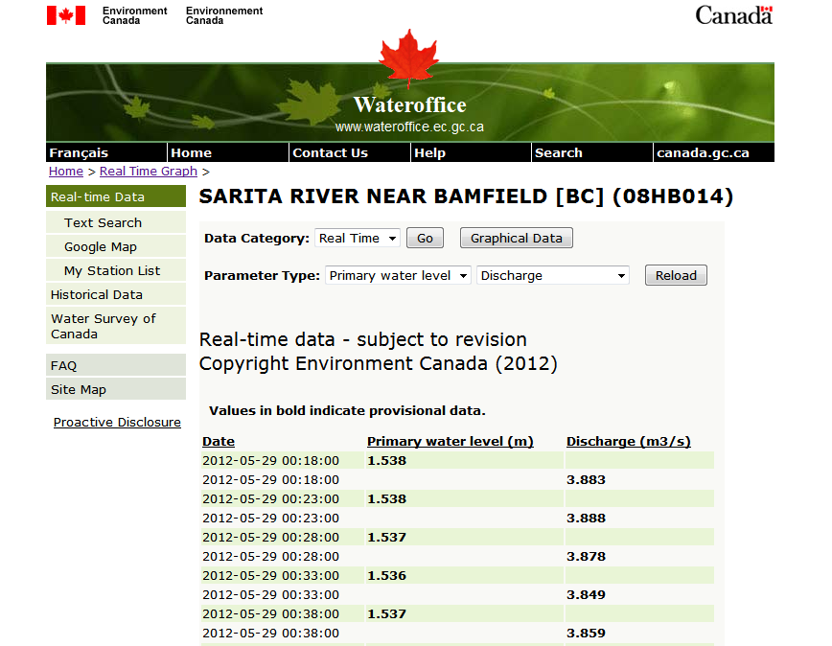
Tables and Reports
Notes:
Tables and Reports. <c> This is an example of a table of water levels that can be extracted from a web based visualization tool. This example is taken from Water Survey of Canada, which is part of Environment Canada. <c> You will note that the real-time web page has a disclaimer, which is typical of web sites that present raw data.
This web page allows you to select <c> a data category, where you can select either real-time or historical data. You can select the <c> parameter (pause) <c> as well as the sensor. Data is neatly organized in columns, with <c> the first column to the left providing the date and time stamp, (pause) <c> the next column to the right providing the water level reading, (pause) <c> and the next column to the right providing river discharge.

Slide 14
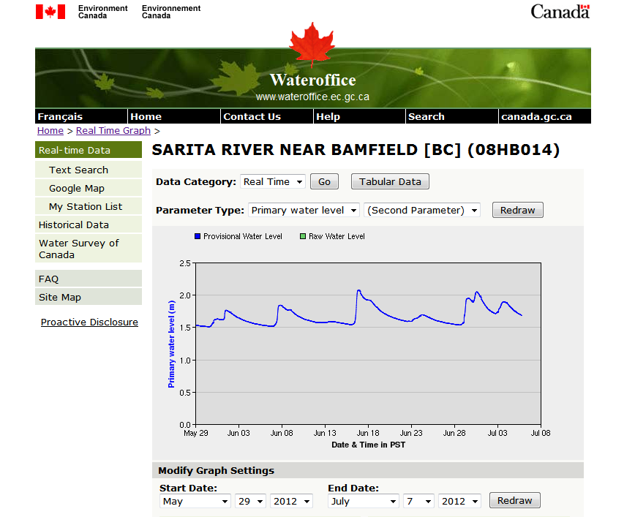
Plot
Notes:
Plots. <c> here is the same website from Environment Canada showing a web page that allows for the plotting of data. This type of capability should be part of your HIS, and available as a web page, like this one. This site allows you to enter <c> the data category. For instance, the data category can be either real-time, or historical. There is an entry <c> for the parameter that you wish to display, in fact this web page allows you to <c> enter a second parameter. <c> the date range is also a field to be entered, and after all of these items are entered, <c> the web site yields a plot with what you have requested.
I have chosen this example because of the ease of use in rendering plots.

Slide 15
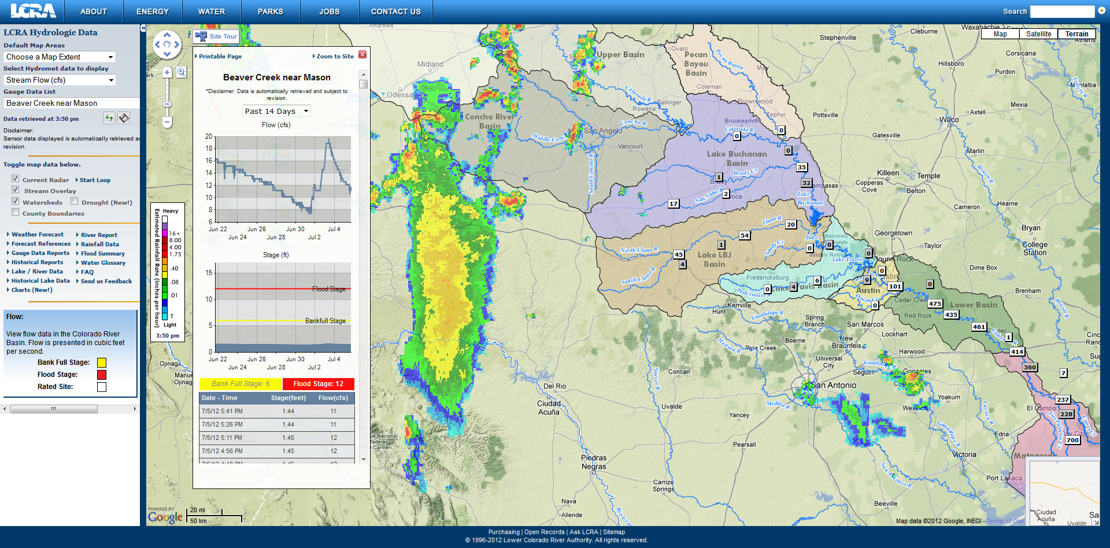
Map Interface
Notes:
Map Interface. The following screen shot shows an example of an excellent map application, that allows a variety of data to be displayed, along with data that is received by data exchange from another agency.
Again, this screen allows entry of fields so that the user can have the map of interest provided by the web site. In the upper left corner <c> the user can select the precise area to be mapped, as the default would be the entire project area. The second input <c> indicates the measurement that is desired, and the <c> third input is the station name for the graph that is to be displayed. the entire stream flow network is plotted, and is indicated <c> by the red arrows.
This system <c> has integrated weather radar from the national meteorological center (acquired through data exchange) and displayed this on the map. The final panel <c> is a plot with indications a high water for the station that was chosen in the upper left selection box.

Slide 16
Advanced Data Visualization Sites (Public)
National Water Portal for Canada
  http://www.wateroffice.ec.gc.ca/
National Water Portal for the USA
  http://water.usgs.gov/nwis
State Water Portal of California
  http://cdec.water.ca.gov/
Water Portal for Regional Water Authority
  http://hydromet.lcra.org/
Water Portal Supported by Innovative Hydrology
  http://ih-mark.dyndns.org:8080/caweb/tw/
Notes:
These sites are examples of water information portals. These portals display data in numerous forms from real-time reporting remote stations.

Slide 17
Data Exchange and Dissemination Module
Includes Data Exchange (Push/Pull)
Web pages (Pull)
SMS Text Messages (Push)
Push Technology
Data Server
Pull Technology
Notes:
Data Dissemination Module. <c> Data exchange and dissemination can occur through a push or pull technology. <c> This visual demonstrates both push and pull technologies. <c> A push technology is where the server that is immediately collecting data sends the data, or some form of the data to the user. <c> Pull technology is where the <v> user requests data from the server and <c>the server returns the data requested. <c> A website is a good example of a pull technology, where the use requests data from the website. <c> SMS TEXT messages triggered by alarm conditions that are evaluated automatically by server side software is an example of Push technology. Push technology should be employed in the development of an early warning system. Push technology should also be utilized when exchanging data with partners, as it provides a time efficient method of data dissemination.

Slide 18
Data Exchange and Dissemination
DSS
WEB Portal
Research & Development
Cooperating Entity
HIS
IMD
State Government
Early Warning
CWC
Notes:
Data Exchange and Dissemination. Real-time data exchange can multiply the benefits of an HIS. Information can be moved automatically to and from other HIS platforms. HIS communication and data sharing can save costs by making data much more effective. In the example below, we have a <c> HIS, the HIS can <c> exchange data to the web portal, and also <c> exchange data with the DSS, <c> and exchange data with research and development units, <c> or IMD, or <c> an early warning system, or <c> CWC, or, <c> a cooperating State Office, or <c> any other cooperating entity. By moving the data in such a way, the benefits of the data can be multiplied as many institutions can benefit from a data stream that is shared.
As you can see, Data exchange involving an HIS, especially a centralized HIS, performs as a wheel, where information moves from the hub to the outer rings, and from the outer rings to the hub. One of the systems on the outer ring can exchange information with the HIS, and the HIS can then store the data and exchange the data with another data exchange partner.

Slide 19
Ancillary Software Modules
Virus Protection
Backup Software
Remote Assistance
Notes:
Ancillary Software Modules. You shouldn’t forget to specify software that will help in securing your computer network, as well as securing your data. <c> Virus protection should be specified, along with <c> backup devices with backup software will help help protect your information. Most server class computer systems come with remote assistance, where a technician that may be remotely located can help you troubleshoot your system.

Slide 20
Hardware Components and Principles of a HIS Management System
Rack mount Computer Server(s)
Uninterruptable Power Supply
Internet Service
Modems, Routers, Hubs
Backup Power Supply
Power and Environmental Conditioning
Notes:
Hardware components and Principles of HIS management System. This slide presents information on components required for your HIS computer system. The HIS computer system usually consists of <c> rack mount computer servers, and <c> an uninterruptable power supply, <c> internet service, and <c> modems, routers, switches and hubs a <c> backup power source if continuous operation is required, and <c> power and environmental conditioning. This slide serves as reminder of the components required. These components will be further described in the following slides.

Slide 21
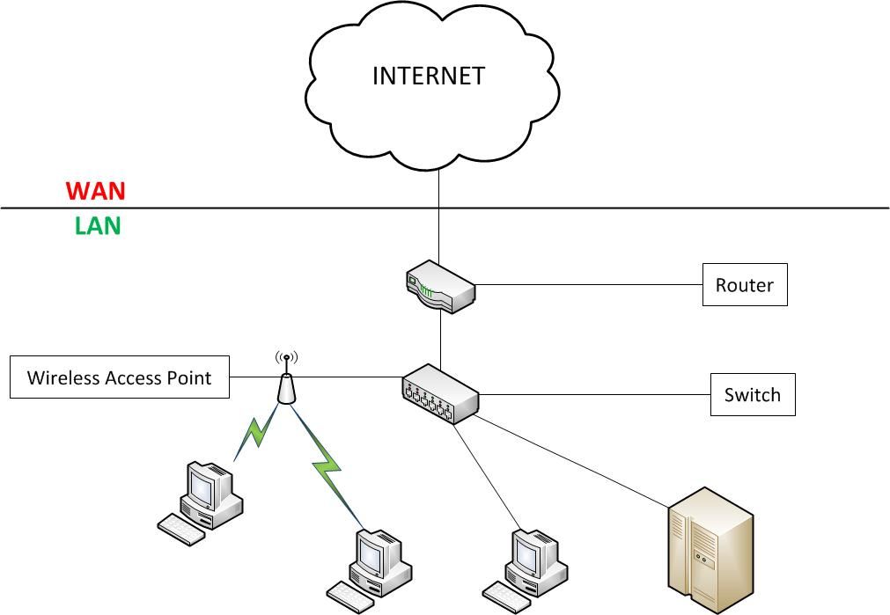
Notes:
The slide is an example of the typical components in a Internet/Intranet network. The purpose of this slide is to provide general knowledge of components that support a network working over TCP/IP and the Internet. If these components need to be procured, then you will have a general idea on the purpose of each component. <Laser Pointer> Starting from the Internet, the connectivity from the internet enters the agencies domain through a modem, which is directly fed to a router. The router can act as a hardware firewall, eliminating traffic that is not authorized. From the router, the information goes to a switch (if you have many devices) or a hub, if you only have a few devices. The switch allows for a single connection point for all of your devices, making connection between the Internet and the particular Internet device within the agencies domain. Devices that can be connected to a Switch include Servers (I recommend Rack mount Servers), workstations, desktop computers, printers, and other access points (more switches or a wireless access point).
I would recommend that an Information Technology specialist that works for your agency be included on the team that is building your specifications.

Slide 22
Rack Mount Computer Server(s)
Computer rack offers a well organized solution and security for computer systems
Rack should be procured along with power strips
Rack may hold Modem, Router, Switch/Hub, and UPS
Notes:
Rack Mount Servers. What is a rack mount server? Why is a rack mount server preferred over lets say a desktop server, or a tower server? <c> A computer rack offers a well organized solution and security for computer systems. <c> The computer rack (which is a cabinet) should come with the rails which are used to secure the hardware device to the rack, and a power strip that serves has a very high quality surge protector. <c> Modems, Routers, Switches, Hubs, and a UPS are items that are typically mounted in the computer rack.

Slide 23
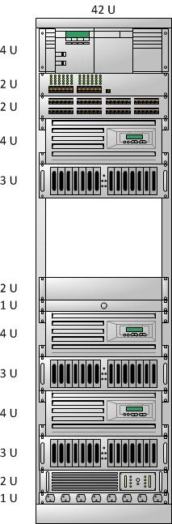
Computer Rack for Data Center
Router
Switch
Patch Panel
Server (Data Collection)
Disk Array
Keyboard and Monitor
Server (Application)
Disk Array
Server (WEB)
Disk Array
UPS
Notes:
This slide shows a typical rack that holds the Data Center Components. The racks can stand 6ft high, and will be used to house your <c> router which will serve as your firewall, and <c> the computer switch, and <c> Patch Panel, <c> The data collection Server, <c> Disk Array for the data collection server, <c> Keyboard and Monitor that can be used for all servers and components placed in the rack <c> the application server, <c> the disk array for the application server, <c> The web server, <c> the disk array for the web server, and the UPS.

Slide 24
Servers and Function
Data Collection Server
Data Processing Server
Web Server
Notes:
Computers and Function. I generally recommend three servers to support the HIS activities. The advantage of three servers over a single server comes with the concept of distributed process. The servers are separated by function, with the <c> first server being the Data Collection Server. The data collection server it the point from which your remotely collected and transmitted data enter the data center. It is recommended to keep this separate, which will make the load on the computer static. In this way we can assure there will be the resources necessary to collect the information, and pass the information on to the data base.
<c> The next server is the Data Processing (also known as the Data Application Server). This will hold the data base and all software components used to perform quality control checks of the data, such as the Time Series Software. <c> The next server is the Web Server. It is very important to keep this server separate. Internet traffic can be very dynamic. You never want the internet traffic interfering with data collection, data processing, or internal use of the information. For this reason the Web Server is kept separate.

Slide 25
Uninterruptable Power Supply
Short term power supply during power outage
  Only servers and systems necessary should be place on the UPS. Lights, air conditioners, and other items of convenience should not be on the UPS supporting the Computer Equipment.
  Usually not more than 20 minutes of operation
  Enough time to switch over to generator
UPS offers surge protection
All systems should have a UPS
UPS should be sized by the Bidder using offered equipment and stated to operate for at least 20 minutes
Notes:
Uninterruptable Power Supply, also known as a UPS. <c> The UPS provides short term power supply during a power outage. <c> Only servers and systems necessary should be placed on the UPS. Lights, air conditioners, and other items of convenience should not be on the UPS supporting the Computer Equipment <c> there is usually not more than 20 minutes of reserve power <c> this is generally enough time to switch to another power source, such as a backup electrical generator. <c> The UPS also offers surge protection. <c> your data center should have a UPS, so make certain you specify a UPS to support your technology related equipment.
<c> The UPS should be sized by the Bidder based on the equipment that the bidder has offered to supply. It should be stated that the UPS must provide at least 20 minutes of electrical power in the event of a power outage. You may indicate 40 minutes, if you want to make certain. Again, the UPS should be based on equipment such as the modem, router, switch, servers, disk arrays, and the single keyboard/monitor that is used to communication with all three server.

Slide 26
Internet Service
Internet service should be of high quality with high availability
Extremely important functions have redundant internet services
Intranet (Internal network using TCP/IP) will be supported by routers, switches, and hubs
Notes:
Internet Service. Internet service is necessary if you wish to have your information accessed outside your agency, or if your data collection requires Internet Service. <c> Internet service should be of high quality and possess high availability characteristics. <c> If your HP-2 application provides services necessary to public safety, or the protection of property, then redundant internet service is highly recommended. The redundant service, carried by a different internet provider, and possibly a different medium, will provide a backup in case on or the other internet service is unavailable.
<c> Intranet, which is the network that operates within and among your agencies computer systems, will only need routers, switches, and hubs.

Slide 27
Modems, Routers and Switches/Hubs
Modem is usually the first connection point from the provider to your building
Router is used to route traffic through your internet
  Routes web traffic to the correct web server
  Routes FTP traffic to the FTP Server
  Used to block unused ports from unwanted access
Switch/Hub pass on network traffic to devices on the network
  Hub is a multi-port repeater
  Switch is a “smart” hub passing information to the correct device (computer/printer)
Notes:
Modems, Routers, Switches and Hubs. <c> As mentioned previously, the modem is usually the first connection point from the provider to your building. <c> the router is used to route traffic through to your agencies network, and also <c> routes web traffic to the applicable web server, <c> routes ftp traffic (if you use FTP), to the server supporting FTP, and also <c> provides the very important function of blocking the use of unused ports from unwanted access.
<c> A switch/hub pass network traffic to devices on your agencies network. <c> A hub is a multi-port repeater that allows you to connect numerous internet devices, such as workstations, printers, desktop, wireless devices, to the internet. <c> a switch is a “smart” hub, which accelerates the movement of information by know which precise internet device is to receive the information. Usually switches are most effective if you have hundreds of internet devices, while a hub will be suitable for very small networks. I would suggest that the HP-2 implementing agencies invest in a Switch, with hubs being used as the network is extended to support 10 or fewer devices.

Slide 28
Wireless Solutions
Provides computing portability
Alleviates issues of building wired topology
Security
  Considered less secure than wired networks
  Wireless signal mitigates access problems as signal can only be received over a relatively short distance (30m)
  Wireless comes with access security where users need to have an encrypted password
Notes:
Wireless Solutions. Wireless access in your network can be very convenient, but also offers a threat to security, even though wireless connection points can be secured with encrypted passwords. Generally <c> wireless solution provide computing portability, which is extremely useful if your agency uses laptops, or if the expense of running wires to each office is prohibitive. <c> as mentioned, wireless solutions alleviates issues a implementing a wired topology, which can be expensive and time consuming (though generally more secure). <c> the security issues surrounding wireless solutions include the fact that <c> wireless access is less secure than wired networks, but <c> wireless signals somewhat mitigate these access threats, as wireless signals can only be received over a generally short distance (usually less than 30m). <c> As previously mention, the wireless solutions can implement access security, where users need to have a password. This password is encrypted as it is transmitted through the wireless topology.

Slide 29
Backup Power Supply
Backup power supply is usually supplied by a generator
Backup power supply is designed to work for hours vs a UPS that is designed to work for less than 1 hour
If you have no backup power supply the best practice is to shut down computers while the UPS is still running
Backup power supply is necessary for data collection that is required
Notes:
Backup Power Supply. If your HIS serves a critical function, then you should consider procuring a backup power supply. A backup power supply is different from a UPS, in that the backup power supplies power over extended time periods, which can last days, while a uninterruptable power supply is intended to provide power for short period, which give you enough time to either turn off your computers or start the backup generator. <c> backup power is usually supplied by a generator fueled with diesel or gasoline. <c> backup power supply is designed to for hours versus a UPS that is designed to work less than an hour. <c> If you have no backup power, the best practice is to shut down computers during the time period where the UPS is supplying power. <c> Backup power is very necessary for data that is used for a critical function, like the safety of the community, or protection of property.

Slide 30
Power and Environmental Conditioning
Adequate Power Supply
Surge Protection
  UPS will provide this
Grounding
Air Conditioning
  Temperature 16 – 24C
  Humidity 40 – 55%
Dust and dirt prevention
Other problematic issues (food and drink)
Notes:
Power and Environmental Conditioning. Your HIS will reside within a computer room, or an area that has proper air and power conditioning to support computer systems. The computer room <c> must have adequate power supply, that <c> is protected from power surge, which can damage computer equipment. <c> a UPS can provide surge protection as well as emergency power. <c> the computer room must be properly grounded in order for the computer system to work properly.
<c> Air Conditioning is required. Air conditioning will filter the air from dust as well as holding the temperature and humidity within acceptable ranges. <c> Air temperature should be kept between 16 and 24 C to assure optimum performance as well as a long lifetime. <c> humidity should be kept between 40 and 55 %. Humidty should be kept sufficiently low to prevent condensation occuring on computer components, and high enough to eliminate static electricity.
<c> as mentioned, dust and dirt should be prevented from entering to area that houses computers. As well <c> food and drink should be avoided in the computer room.

Slide 31
Why is it important to specify data collection computers with field equipment?
✓
✗
✗
✓
✗
a. To assure seamless integration from the field to the Data Center
b. It’s easier
c. It is a World Bank Requirement
d. Supplier may provide telemetry solution that has proprietary aspects
e. Data collection and field equipment should be kept separate
Notes:
The following is a quick review of the content of this module that is presented as a quiz.

Slide 32
What are benefits of “distributed” processing?
✓
✓
✓
✗
✓
a. Data collection can occur uninterrupted
b. Option of Hardware Resource Sharing
c. Can make upgrade easier
d. Equipment can fit into a single cabinet
e. Quicker response time

Slide 33
What are Functions of a HIS System?
✗
✓
✓
✗
✓
a. Office Automation
b. Hydrological Data Collection
c. Hydrological Data Visualization
d. Increase financial wealth
e. Hydrological Data Dissemination/Exchange

Slide 34
End of
Module 7

